Slide 1
What is a database?
(a supplement, not a substitute for Chapter 1…) some slides copied/modified from text
Intro DB
Week 1
Collection of Data?
Data vs. information
Example: first and last names
Data have to be related and organized to model those relationships
→ “An organized collection of related data”. Even if the text says otherwise.

Slide 2
Why a database?
Centralized to separate to shared: from file processing to databases
Example: Redundancy vs. Integrity vs. Security (It’s a tradeoff, duh)
Need extra layer of management (DBMS)
  Analogous to an OS, but for data
  Resource manager and interface provider

Slide 3
How to Design a DB?
Identify the entities that are relevant
  Identify attributes of those entities
Identify the relationships between and among those entities
Organize those entities and relationships such that they can provide useful information while maintaining data integrity, and eliminating data redundancy and data anomalies.
  A good modeling tool is an ER Diagram (ERD)

Slide 4
Features of a DB
Meta-data
  Database definition or descriptive information
  Stored by the DBMS in the form of a database catalog or dictionary
Manipulating a database
  Query and update the database miniworld
  Generate reports

Slide 5
Types of DBs
(based on types of data)
Traditional database applications
  Store textual or numeric information
Multimedia databases
  Store images, audio clips, and video streams digitally
Geographic information systems (GIS)
  Store and analyze maps, weather data, and satellite images

Slide 6
Types of Data Retrieval and Control
(related to DBs)
OLTP (online transaction processing) “conventional” DBs.
Data warehouses and online analytical processing (OLAP) systems
  Extract and analyze useful business information from very large databases
  Support decision making
Data Mining
Real-time and active database technology
  Control industrial and manufacturing processes

Slide 7
DBMS
Database management system (DBMS)
  Collection of programs
  Enables users to create and maintain a database (provides user interface and tools)
  Manages the resources (provides access, security, concurrency controls)
    Concurrency: Ensure that several users trying to update the same data do so in a controlled manner
      Result of the updates is correct

Slide 8
Advantages of Using the DBMS Approach
Controlling redundancy
  Data normalization
  Denormalization
    Sometimes necessary to use controlled redundancy to improve the performance of queries
Restricting unauthorized access
  Security and authorization subsystem
  Privileged software

Slide 9
Advantages of Using the DBMS Approach (cont'd.)
Providing backup and recovery
  Backup and recovery subsystem of the DBMS is responsible for recovery
Providing multiple user interfaces
  Graphical user interfaces (GUIs)
Representing complex relationships among data
  May include numerous varieties of data that are interrelated in many ways

Slide 10
Advantages of Using the DBMS Approach (cont'd.)
Enforcing integrity constraints
  Referential integrity constraint
    Every section record must be related to a course record
  Key or uniqueness constraint
    Every course record must have a unique value for Course_number
  Business rules (“semantic integrity constraints”)
  Inherent rules of the data model

Slide 11
Advantages of Using the DBMS Approach (cont'd.)
Permitting inferencing and actions using rules
  Deductive database systems
    Provide capabilities for defining deduction rules
    Inferencing new information from the stored database facts
  Trigger
    Rule activated by updates to the table
  Stored procedures
    More involved procedures to enforce rules

Slide 12
Advantages of Using the DBMS Approach (cont'd.)
Additional implications of using the database approach
  Reduced application development time
  Flexibility
  Availability of up-to-date information
  Economies of scale

Slide 13
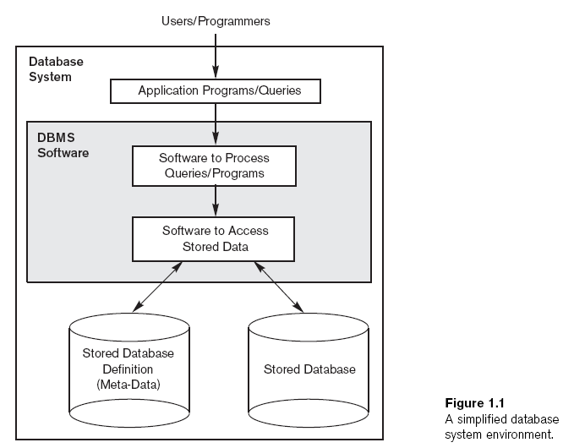

Slide 14
Phases for designing a database:
  Requirements specification and analysis
  Conceptual design
  Logical design
  Physical design
  (This is similar to Systems Analysis, and indeed is part of that process.)

Slide 15
Insulation Between Programs and Data
Program-data independence
  Structure of data files is stored in DBMS catalog separately from access programs
Program-operation independence
  Operations specified in two parts:
    Interface includes operation name and data types of its arguments
    Implementation can be changed without affecting the interface

Slide 16
Support of Multiple Views of the Data
View (more of this in Chapter 2)
  Subset of the database
  Contains virtual data derived from the database files but is not explicitly stored
Multiuser DBMS
  Users have a variety of distinct applications
  Must provide facilities for defining multiple views

Slide 17
Data Abstraction
Data abstraction
  Allows program-data independence and program-operation independence
Conceptual representation of data
  Does not include details of how data is stored or how operations are implemented
Data model
  Type of data abstraction used to provide conceptual representation (discussed more fully in Chapter 2) Think: lego blocks vs. magna tiles.

